Slide 1
IMS Project
Benediktas Noreika

Slide 2
Introduction
-A little bit about me…
-How I approached the given specification:
An inventory system was required to track customers, their orders and different items
Things needed: A cloud SQL database, backend CRUD functionality, User interface
Extendable OOP approach.

Slide 3
Consultant Journey
-Already familiar with some of the technologies required
-But many new ones learned such as:
Jira
Maven
Mockito
Git
Considerably advanced Java knowledge
Google cloud

Slide 4
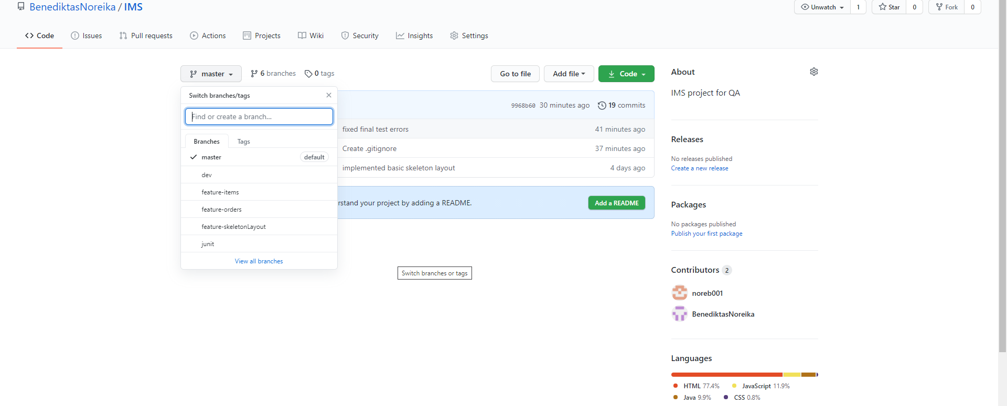
Version control
-Used git and github

Slide 5
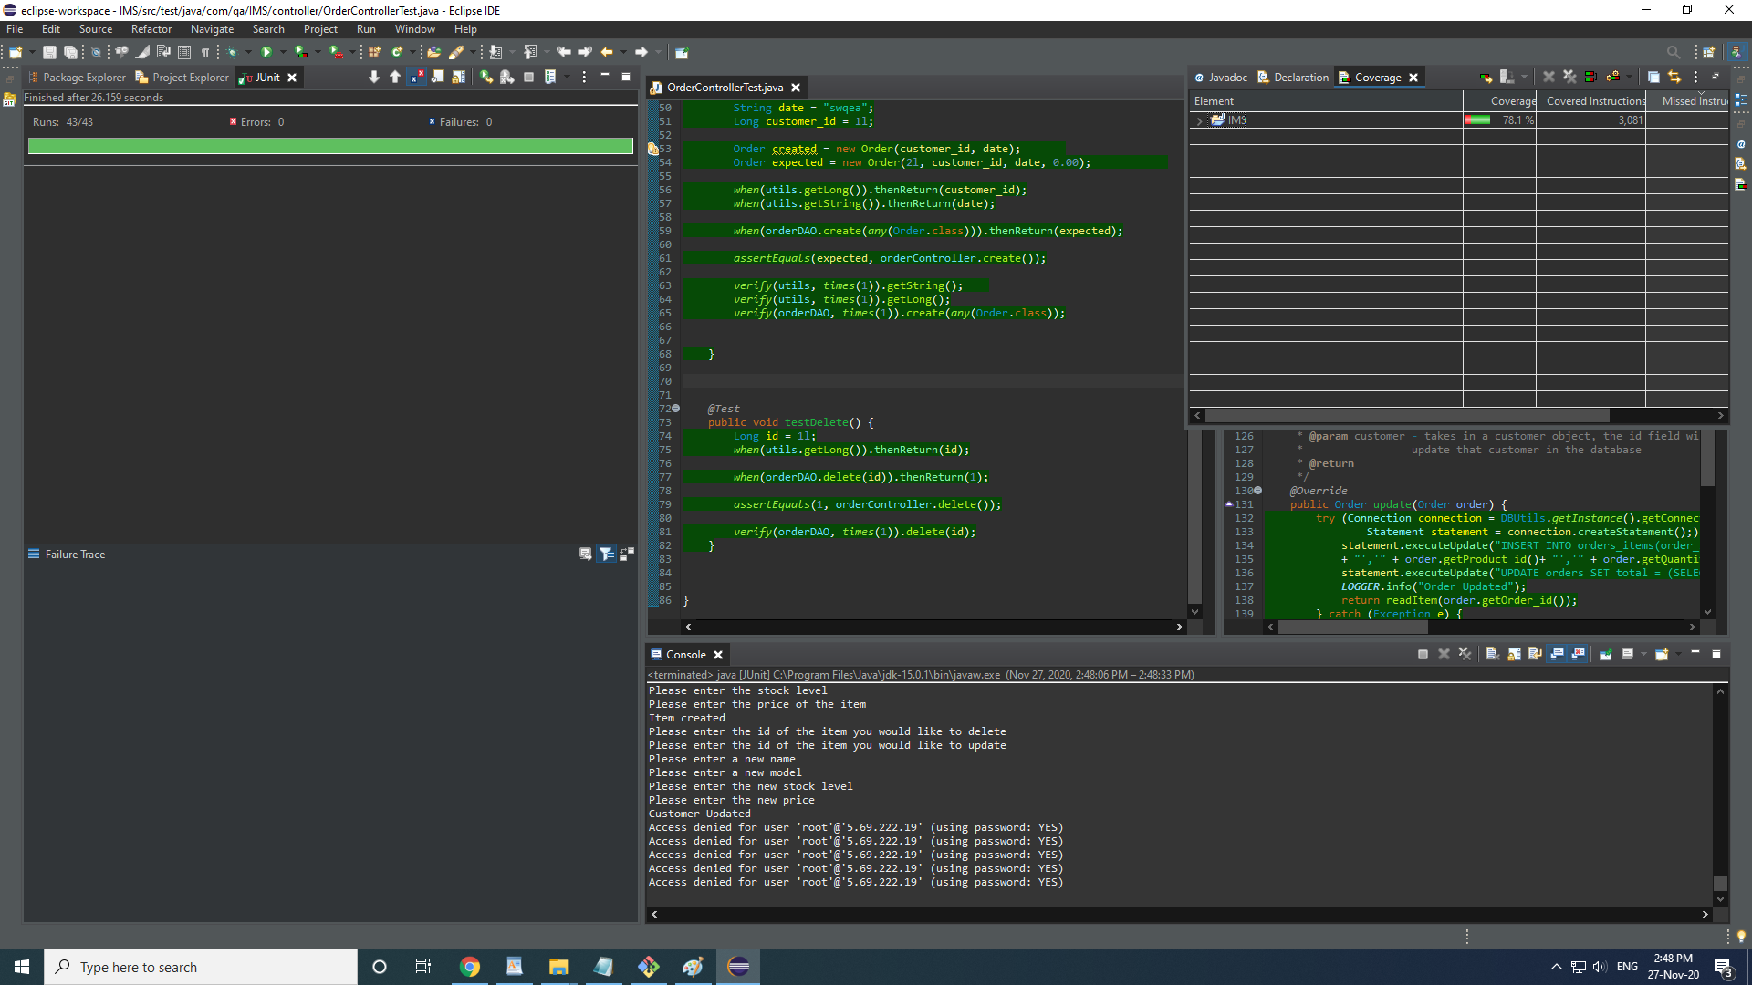
Testing

Slide 6
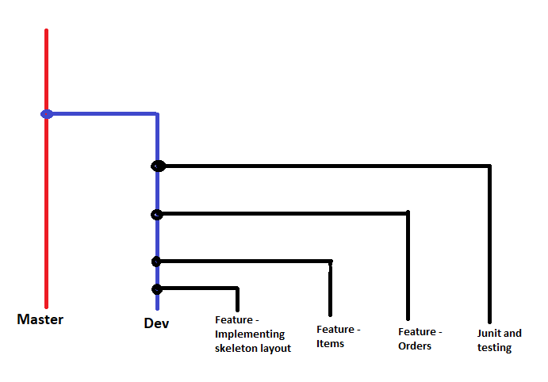
Version control - branching

Slide 7
Demonstration...
User Stories…
I want to add a customer to the system
I want to add a product to the system
I want to create and order for a customer
I want to add items to a customer
I want to delete a customer

Slide 8
Sprint review
-Sprints conducted in two days for one major branch
-Base specification requirements met set out in the project plan
-However, extra features not added in such as Discount feature, extra testing.

Slide 9
Sprint retrospective
-Overall the project was a success as it met its goals
-Things to improve….

Slide 10
To conclude
Future steps: Add more feature, better error handling
Things learned not to do next time…
Better variable naming in database
A more test driven design
Do a jar build a few days before deadline to iron out any last minute problems

Slide 11
Thank you for listening
Happy to take any questions

